Slide 1

Topic: Deep Quaternion Networks & Quaternion Recurrent Networks
Presenter: Joseph Lopez

Slide 2


Who Am I?
UCI Student:
  Senior CS Major
Data Science Boot camp:
  16 week applied course

Slide 3
Outline
Part 1 – What are Quaternions?
  The History
  The Math
  Their Applications
Part 2 – Deep Quaternion Networks
  Convolutions, Batch Norm, Weight Init
Part 3 – Quaternion Recurrent Networks
  Backprop through time
Part 4 – Future Directions
  applications
  GHR Calculus
  Clifford Algebras

Slide 4
Part 1: What Are Quaternions?
The History:
  Sir William Rowan Hamilton (1806 – 1865)
  Overview Quaternions vs Vectors (1840 – Present)
The Math of Rotation:
  Rotation matrix and Euler Angles
  Complex numbers and Quaternions
Their Applications:
  Gimble Lock
  Applications: Graphics, Navigation, Quantum mechanics

Slide 5
The History
Sir William Rowan Hamilton (1806 – 1865)
  His Career
    What he did
  His Story
    Inventing Quaternions
Quaternions and Vector analysis
  Grassmann
    Exterior product and vector spaces
  Influencers of the era
    Maxwell, Peirce

Slide 6
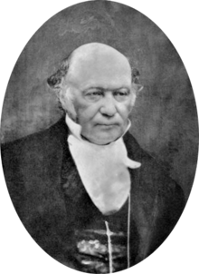
Sir William Rowan Hamilton
Lived his life in and near Dublin, Ireland
made contributions to optics, dynamics,
and algebra.
Influential in dev of quantum mechanics
and vector analysis
Wanted to generalize complex numbers to
describe 3d space.

Slide 7
His Career
Optics
  Ascribed characteristic functions to light rays to describe optical refraction and manipulation of light (focusing light with mirrors)
Dynamics
  Associated a characteristic function with any system of attracting/repelling particles
Algebra
  Extended complex numbers while providing conceptual basis for vector analysis

Slide 8
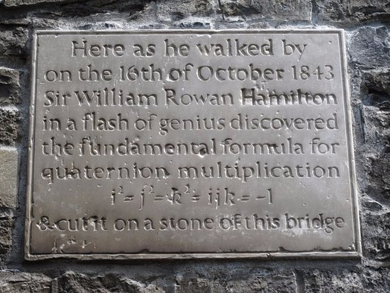
His Story
Tried to use 3 numbers to describe 3d motion
Was able to do it with 4 instead of 3 which was was later proven to be impossible (composition algebras)
Real part can be scalar while the imaginary parts a 3d vector.
Multiplication of two zero-scalared quaternions (2 3d vectors) results in a quaternion who’s real component is the dot product and whose imaginary components are the cross product of those 2 3d vectors

Slide 9
Quaternions and Vector Analysis
What work was being done at the time?
How do Quaternions relate to 3d vectors?
What were the opinions of the influential academics of the era?
How did Quaternions lead to the development of linear algebra?

Slide 10
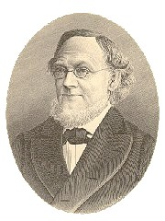
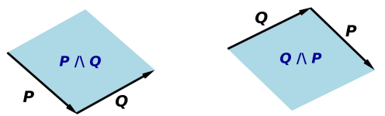
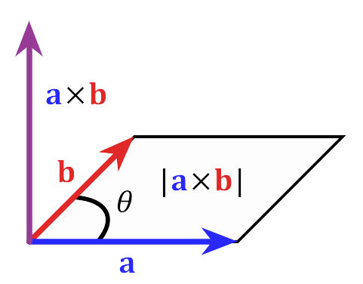
Grassmann
Grassmann and vectors 1840’s
  Exterior product
    Study areas (bi-vectors),
    volumes (tri-vectors), etc.
  Generalized vector spaces
    Not limited to 2 or 3d
  Ignored for decades
    Remained in obscurity until
    it was incorporated into Gibbs
    work on the formalization of the
    dot and the cross product

Slide 11
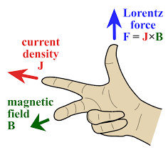
Influencers of the Era
James Clerk Maxwell
  Originally wrote his EM equations partly in quaternion
  notation bur changed to coordinate notation to make
  his work accessible to people unfamiliar with the notion
  in 1873
Benjamin Peirce
  Harvard Prof interested in celestial mechanics who
  expanded quaternions and published the first linear
  algebra textbook in the 1870’s

Slide 12
The Math of Rotation
Rotation matrix and Euler Angles
  Rotation matrix
  Euler Angles
Complex and Quaternion Numbers
  Complex algebra
  Quaternion algebra

Slide 13
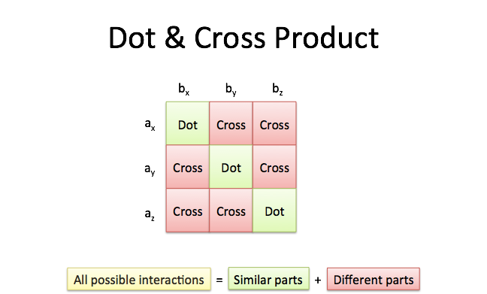
Rotation Matrix and Euler Angles
Basic Linear Algebra:
  Dot product:
    A * B = ||A|| ||B|| cos Θ
  Cross Product
    A x B = ||A|| ||B|| sin Θ

Slide 14
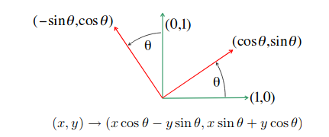
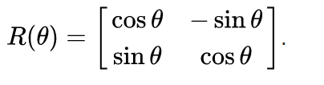
Rotation Matrix and Euler Angles
2D Rotation
  Make new basis in matrix
  to rotate by Θ
  Is Orthogonal like original basis
    Ie no sheering

Slide 15
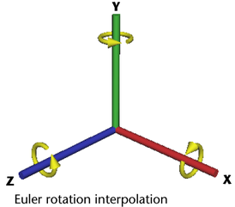



Rotation Matrix and Euler Angles
3D rotation
  Break space into 3 2d projections
  Find rotation matrices for each
  Extrapolate into 3d space

Slide 16
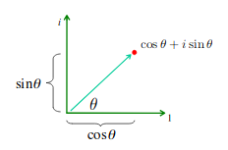

Complex and Quaternion Numbers
Complex Numbers
  s.t.
  Originally invented to solve quadratic equations involving
  Add:
  Mult:
  Rot:
  Euler’s Formula:
  Tldr: mult by rotates a vector ccw by

Slide 17
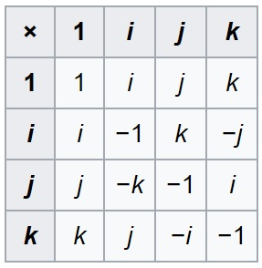
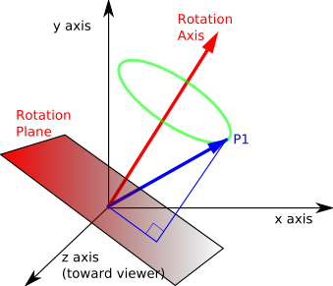
Complex and Quaternion Numbers
Quaternion Numbers
  s.t.
  Properties:
    Real set to 0 results in mult being cross and dot prod
    Real set to 1 results in mult describing 3d rotation
  Add:
  Non-Commutative Mult:
  Exp form:
    s.t.

Slide 18
Their Applications
Gimble Lock
  Belt Trick, Gyroscope
Applications
  Computer Graphics
  Aerospace Guidance
  Quantum Mechanics

Slide 19
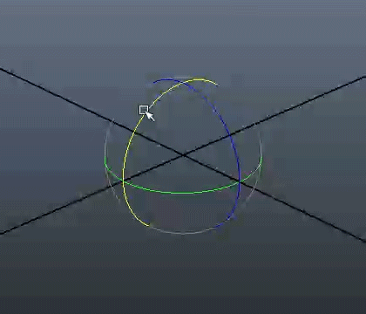
Gimble Lock
The loss of a degree of
freedom due to a Cartesian
based orientation control
sequence.
In 3d if two axes align, you
can’t tell which of the two
aligned axes an orientation
is coming from.

Slide 20
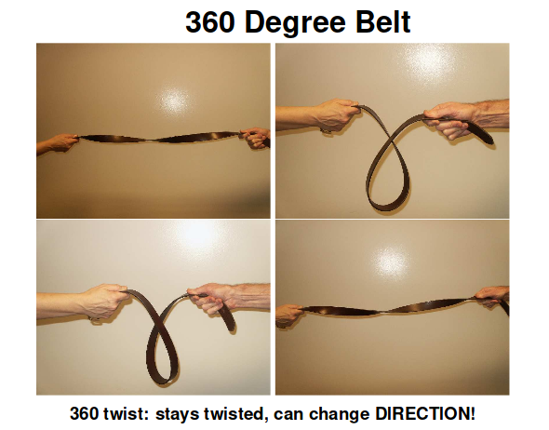
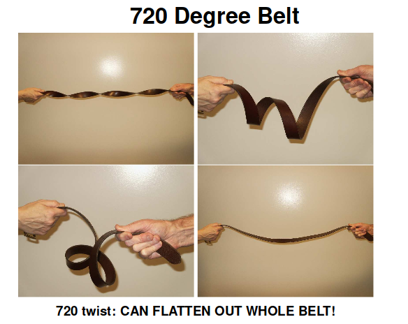
The Belt Trick
Euler angles use 3 angles each representing up to 360 degrees of rotation while quaternions use 1 angle for 720 degrees of rotation.

Slide 21
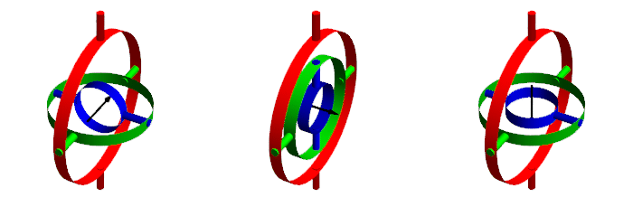
Gyroscope
A Gimble can be thought of as a fixed axis of rotation. With Euler angles, to represent rotations you would decide on an ordering of rotation matrices which would be used and and updated to express changes in orientation. If Gimble lock occurs, it is impossible to fix the axes without an external reference.

Slide 22
Applications
Computer Graphics:
  Unity hard codes rotations in quaternions, giving the user the option to use them or Euler angles (which can be simulated with said quaternion representation). Allows for smooth rotations.
Aerospace Guidance
  More compact representation (4 vs 9 nums) results in lower computation error, more resilient against perturbations (an slightly off quaternion still represents rotation while a slightly off matrix may not be orthogonal anymore). All good for guidance and navigation systems.

Slide 23
Applications
Quantum Mechanics
  Objects related to quaternions arise from the solution of the Dirac equation for the electron where the algebra’s non-communative property is essential.
    To rotate a particle you rotate its wave via complex nums
    To rotate an electron quaternions can be used
  The quaternions are closely related to various spin matricies of quantum mechanics

Slide 24
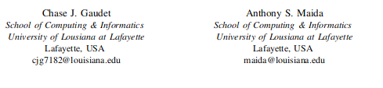
Part 2: Deep Quaternion Networks

Slide 25
Deep Quaternion Networks
Abstract’s TLDR:
  Provide components to build a deep quaternion net
  Develop novel quaternion convolution, quaternion weight initialization, and quaternion batch-norm
  Tested on classification and segmentation task
  State improved convergence while having fewer parameters

Slide 26
Deep Quaternion Networks
Introduction
Motivation and Related Work
Quaternion Network Components
Experimental Results

Slide 27
Introduction
Batch Norm: Regularize net & provide faster/stable training by standardizing activations according to minibatch stats
Shortcut Paths: connecting later layers w/ earlier layers, stronger backprop, help fight against vanishing gradients.
Complex RNNs faster/more robust learning
Work has been done on complex nets ( and quaternion signal processing

Slide 28
Motivation and Related Work
The Ability of quaternions to effectively represent spatial transformations and analyze multidimensional signals makes them promising. Quaternions can be represented as complex groups providing for more robust and efficient mechanisms than can real or complex representations.
PoseNet: Target output was a quaternion to recover 6-DOF camera pose from an RGB image.
Quaternion signal processing: Signal in phase of an image can be sufficiently recovered magnitude (real component).
Quaternion Convolutional filters: real as gray scale, RGB as imaginaries w/ masks

Slide 29
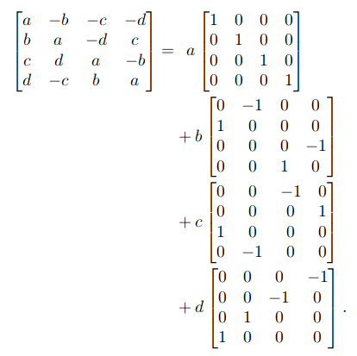
Quaternion Network Components
Quaternion representation
  Intro to Hamilton and Quaternions
  Quaternion arithmetic using reals
    Real Mapping is used for paper but
    others like exist
  2D Convolution layer
    Given N feature maps, divide into 4 separate
    components and give to each quaternion channel

Slide 30

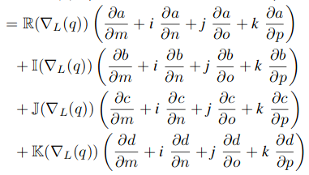
Quaternion Network Components
Quaternion Differentiability
  Provide quaternion chain rule for backprop for real valued functions
    L as loss func, quaternions q = a+bi+cj+dk and g = m + ni+oj + pk

Slide 31
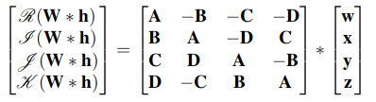
Quaternion Network Components
Quaternion Convolution
  Convolving a quaternion filter matrix W = A + Bi + Cj + Dk by a quaternion vector h = w +xi +yj +zk where A, B, C, D are real valued matrices and w,x,y,z real valued vectors results in the following once reduced into matrix form.

Slide 32
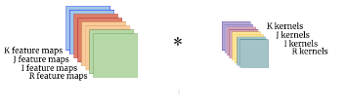

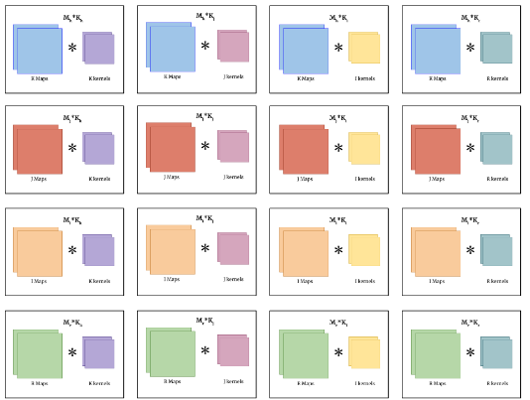
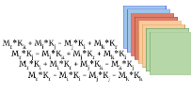
Quaternion Neural Networks
Quaternion convolution produces a unique linear comb for each axis per result of single axis.
This forces each axis of the kernel to interact w/ each axis of image (RGB & Grayscale).

Slide 33
Quaternion Neural Networks
Quaternion Convolution
  Similar to combo of standard & depthwise separable convolutions
    Depthwise separable convolutions: flat kernel applied separately to each feature map (RGB & Grayscale)
      1x1 convolution applied to them to produce linear interaction of feature maps
  Network’s reuse of these filters on every axis may help extract more info across channels
  Since Quaternions can be thought of as a vector, kernels and feature maps of quaternion convolution can be thought of as vectors as well

Slide 34

Quaternion Neural Networks
Quaternion Batch Norm
  No easy normalization (mean of 0, std of 1) exists for complex/hypercomplex nums
  Whitening approach used as there’s no easy way to invert a M(4,R) matrix
    Whitening decorrelates the input dimensions (cov is Identity matrix)
    Cholesky decomposition of cov matrix used instead to find W
      Algo to decompose a symmetric matrix into a lower and an upper triangular matrix A = L * L’
  Whitening accomplished by where W is found by cholesky decomp of cov matrix V

Slide 35
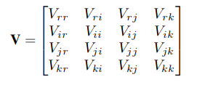
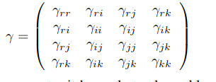
Quaternion Neural Networks
Quaternion Batch Norm
  Cov matrix V given by where each
  V is cov between real and imaginaries
  Real batch norm has 2 learned params
    Shift param which is quaternion valued in our case
    Scale param which is a symmetric matrix according to cov matrix

Slide 36

Quaternion Neural Networks
Quaternion Batch Norm
  Since cov( ) = Identity matrix diagonal of set to to obtain a modulus of 1 for variance of normalized value
  Quaternion batch norm defined as

Slide 37


Quaternion Neural Networks
Quaternion Weight Initialization
  Begin by finding var of a quaternion weight
  Where |W| is magnitude, Θ and Φ angle args and
  Variance is defined by
    Since W is symmetric about 0, second term is 0.

Slide 38



Quaternion Neural Networks
Quaternion Weight Initialization
  No easy way to calculate Var(W)
    Use integration on |W|
      f is pdf for the 4DOF normal distribution
      Express Var(W) by single param σ
  Follow setup from another paper
    Set equal to , solve for
    In case if RELUs: solving gives
`

Slide 39
Quaternion Neural Networks
Quaternion Weight Initialization
  Can init |W| according to pdf parameterized by σ
  Angle components Φ and Θ initialized according to normal
  distribution between – π and π to constrain Φ

Slide 40
Quaternion Neural Networks
Experimental Results
  Architectures used
    3 stages of repeating residual blocks
    More efficient way to do quaternion nets for image input
  Image classification
    using CIFAR-10 and CIFAR-100 benchmarks
    32x32 colored images of 10 & 100 classes
  Image segmentation
    using KITTI Road Estimation benchmark
    Large colored images of varying size from driver’s POV
      Each pixel has corresponding integer label saying if it is part of a road or not

Slide 41

Quaternion Neural Networks
Architectures
  Additional residual block after input to learn complex/quaternion components
    Have one of these blocks per imaginary component concatenated w/ original
      For quaternion net, if input is an RGB image, grayscale and RGB can be 4 axes instead
  All architectures had 3 stages of these repeating residual blocks
  where images are downsized via a strided convolution

Slide 42
Deep Quaternion Nets
Image Classification
  CIFAR-10/CIFAR-100
    Images w/ 10 & 100 labeled classes respectively
  Experiment
    Shallow and deep real, complex, and Quaternion nets
  Results
    Longer to train, outperform w/ less params

Slide 43
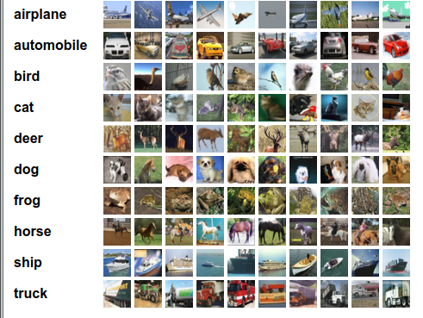
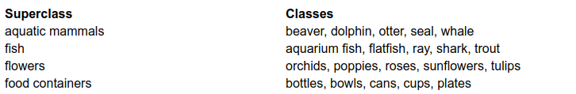
Deep Quaternion Networks
CIFAR-10
  60,000 32x32 images of 10 classes
    600 images of each class (500 train,
    100 test)
CIFAR-100
  CIFAR-10 except 100 classes
    20 super classes containing 5 classes each

Slide 44
Deep Quaternion Networks
Experiment
  Network types: real, complex, quaternion
    One shallow and one deep net for each type on both CIFAR benchmarks
      Shallow: stages contain 2, 1 and 1 residual blocks
      Deep: stages contain 10, 9, and 9 residual blocks
      Each stage doubles previous’s num of convolutions
        Ex: real had 34 kernels, 64, then 124 in last stage
  Parameter budget:
    Convolutional filters
      2x less for complex
      4x less for quaternions
  Training:
    SGD w/ Nestrov momentum of .9
    Gradients clipped to 1
    Custom training schedule (same as in paper on complex nets for comparison)
      .01 for 10 epochs, .1 for 11-100 epochs, cut by 10 at 120 and 150 epochs

Slide 45
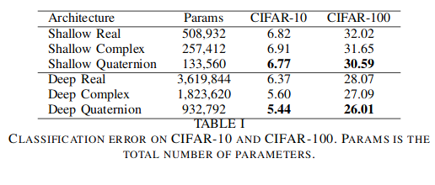
Deep Quaternion Networks
Results:
  Quaternion outperformed real & complex nets on both data sets w/ fewer params
  Quaternion models took ~50 % longer to train due to computation heavy quaternion batch norm

Slide 46
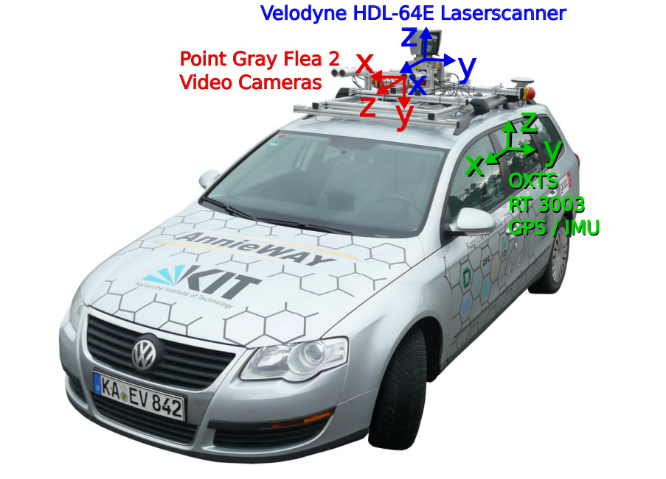
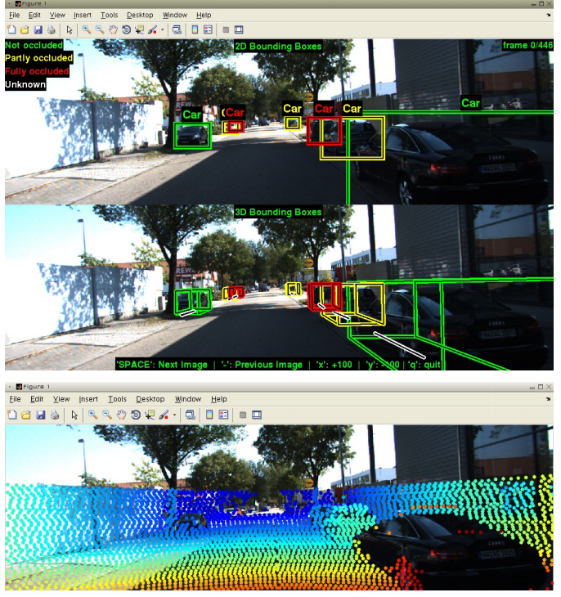
Deep Quaternion Networks
Image Segmentation
  KITTI Data set
    Designed or 3d object detection & tracking,
    stereo, optical flow, and visual odometry
    Real world CV benchmark from driver’s POV
    Images labeled w/ integer heatmap saying
    if a pixel is part of a road or not
    Large images (~1200x375)

Slide 47
Deep Quaternion Networks
Experiment
  Used only shallow nets like in classification experiment due to resource limitations.
    (2, 1, 1) residual blocks at 3 stages
    No strided convolutions
    No global average pooling/fully connected layer at end
    1x1 convolution w/ sigmoid activation at end to produce heatmap similar to input
  Same training procedure but different learning rate scheduler
    .01 for 1st 10 epochs, .1 for 11-50 epochs, divide by 10 at 100 and 150 epochs

Slide 48
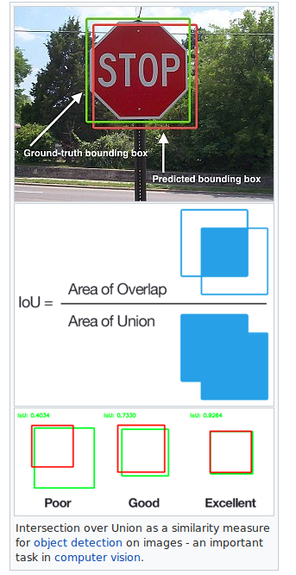
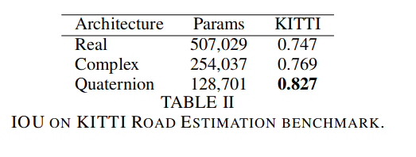
Deep Quaternion Networks
Results
  Used Intersection Over Union (IOU) metric
  Quaternions outperformed other 2 by large margin
  than classification task w/ smaller param count.
IOU is Jaccard index:
complement can be used
as distance metric for
dissimilarity between
sample sets

Slide 49
Deep Quaternion Networks
Conclusions
  Quaternion Recurrent Neural Networks
    Reduce number of free params by 3x to reach same/better results
    Novel backprop through time algo
  Learning Algo’s in QNN using GHR calculus
    Optimization on Quaterions themselves instead of on cov matrix
  Clifford Algebras
    Neural computation in geometric algebras that aren’t quaternions

